Slide 1
Generative Image Inpainting with Contextual Attention
CVPR2018

Slide 2
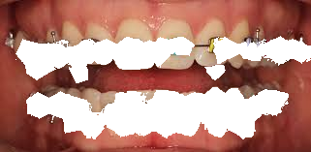
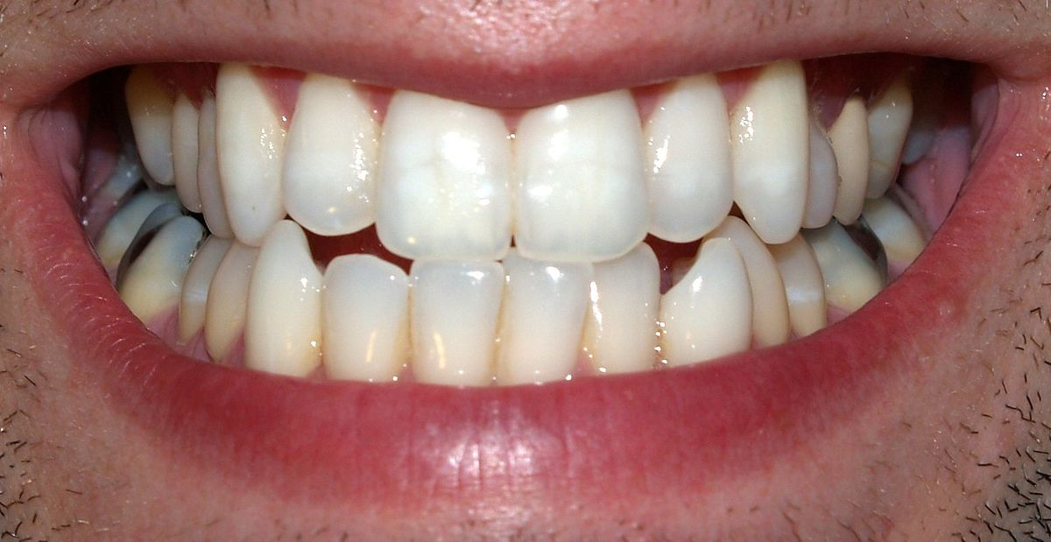

Hướng giải quyết
Segmentation $→$ Inpainting
Manual delete $→$ Inpainting
Segmentation:
Inpainting: GAN

Slide 3
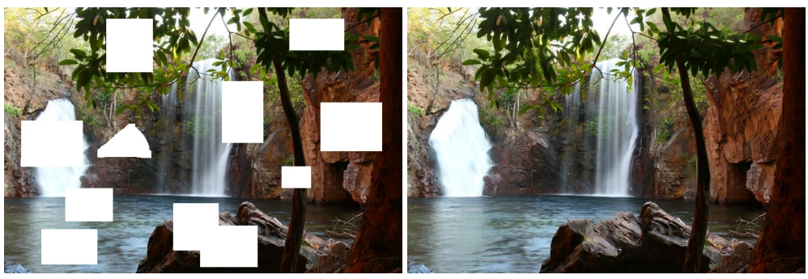
Inpainting

